Slide 1


Slide 2
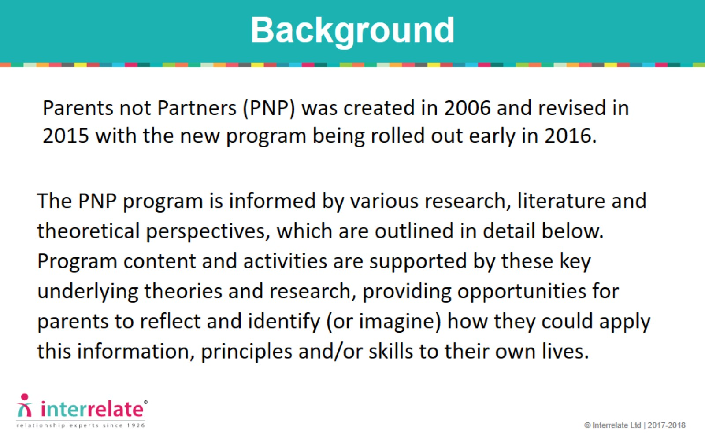
Background

Slide 3
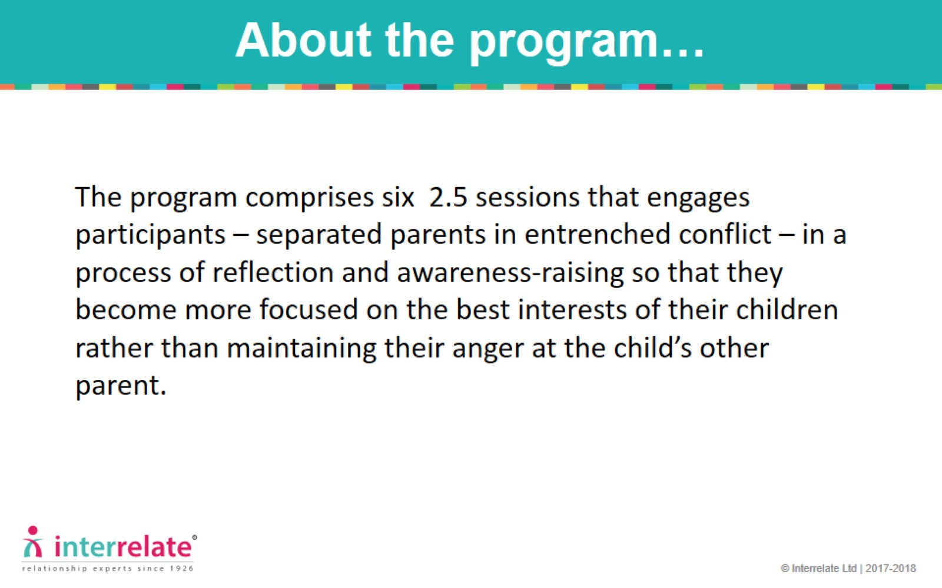
About the program…

Slide 4
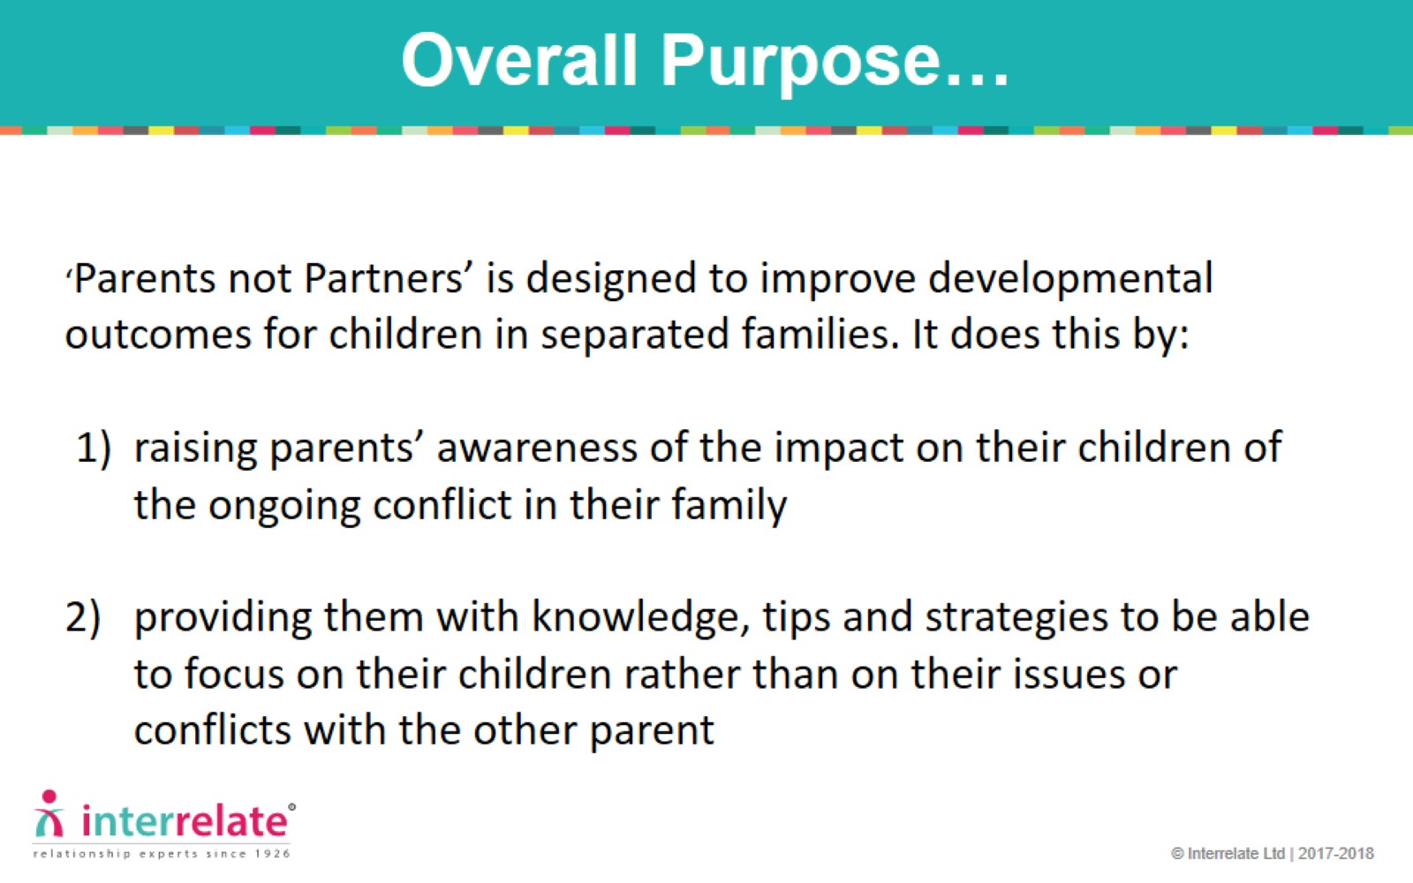
Overall Purpose…

Slide 5
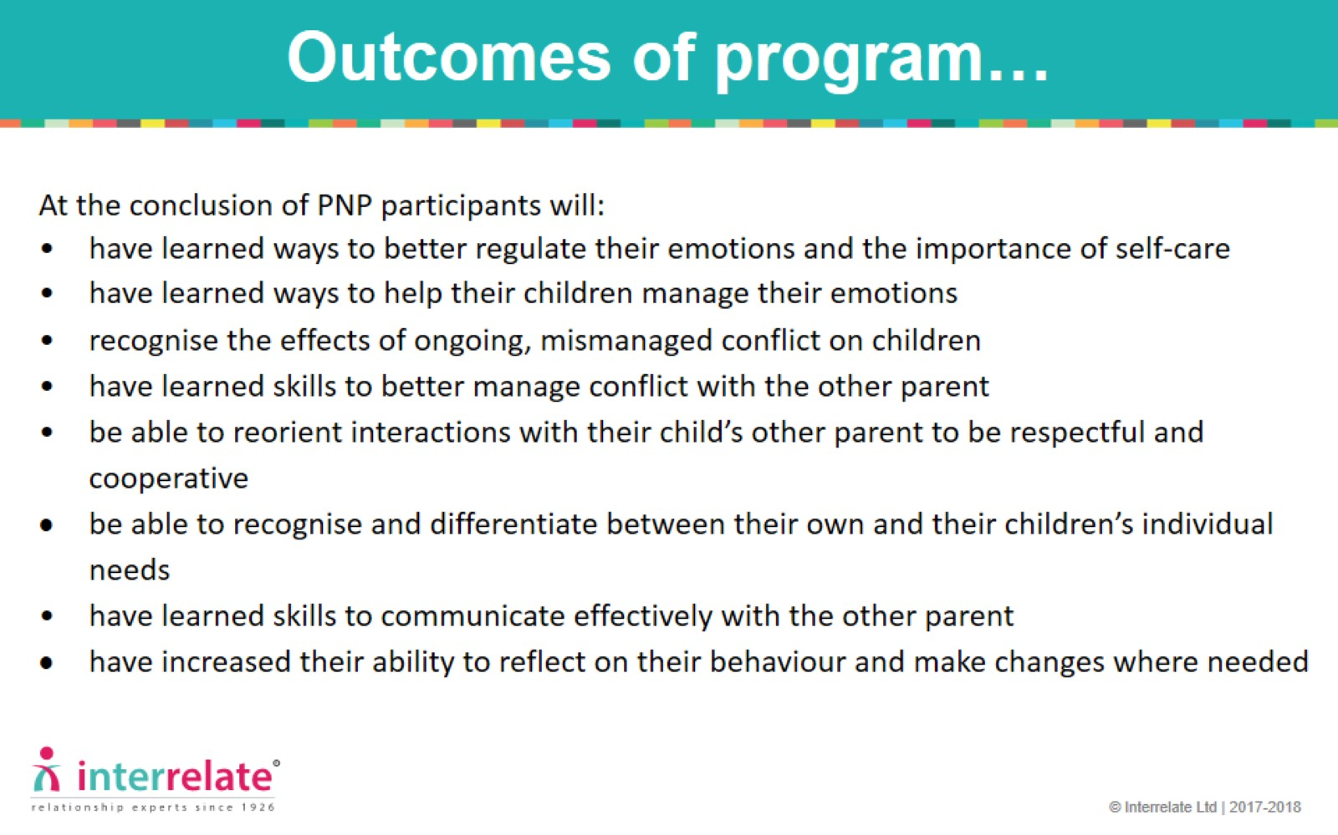
Outcomes of program…

Slide 6
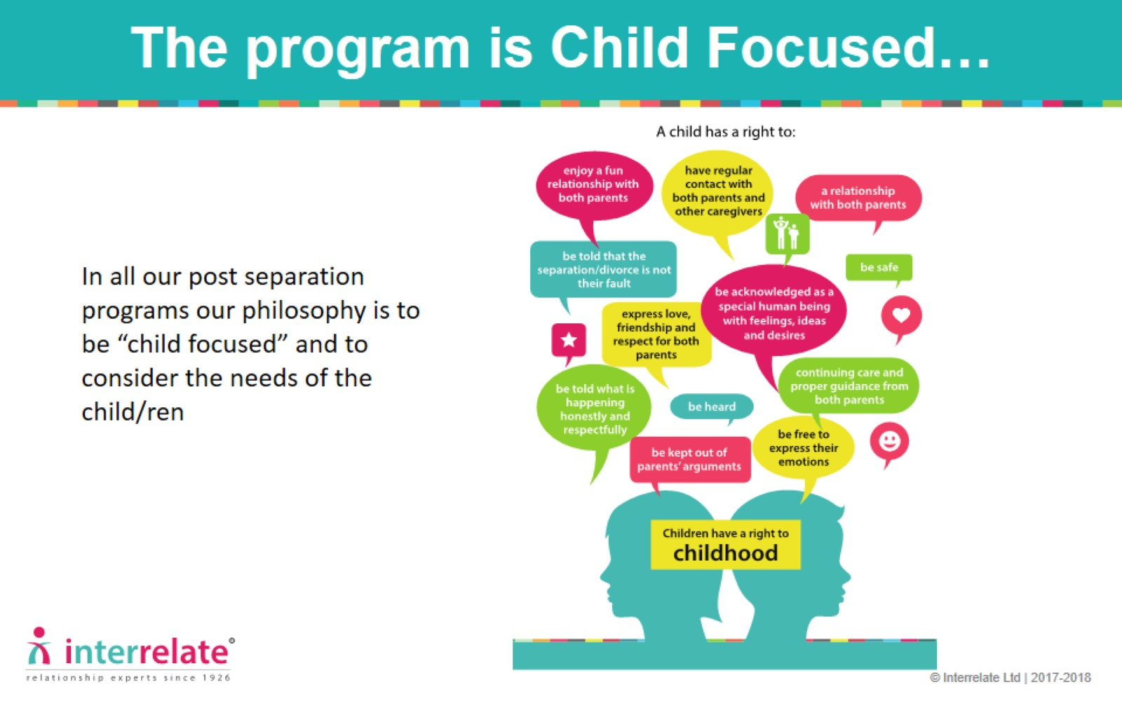
The program is Child Focused…

Slide 7
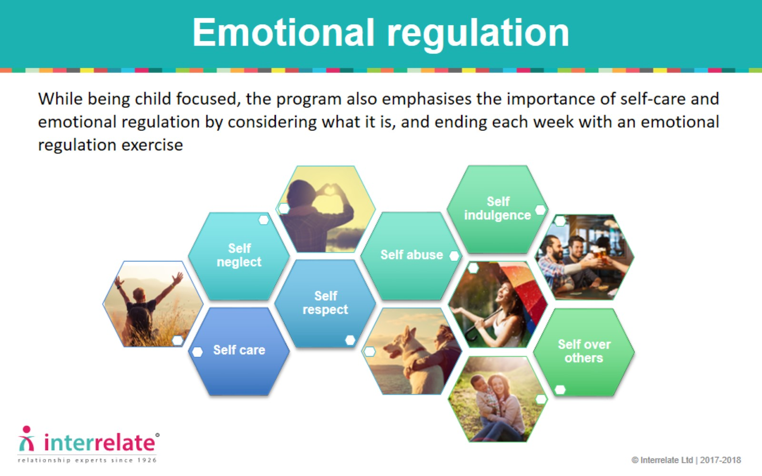
Emotional regulation

Slide 8
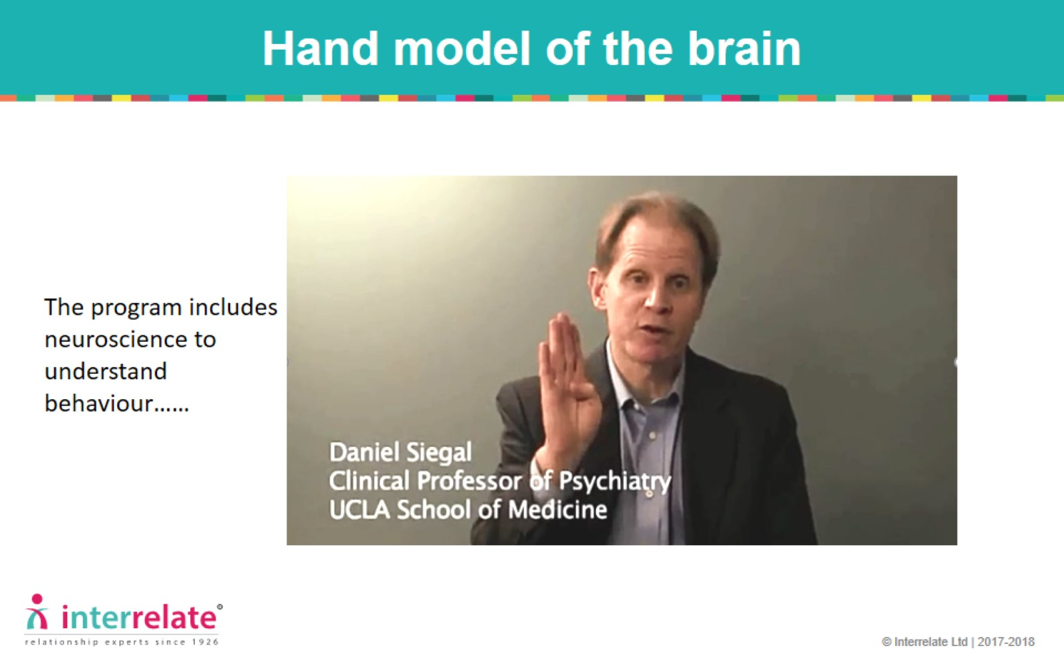
Hand model of the brain

Slide 9
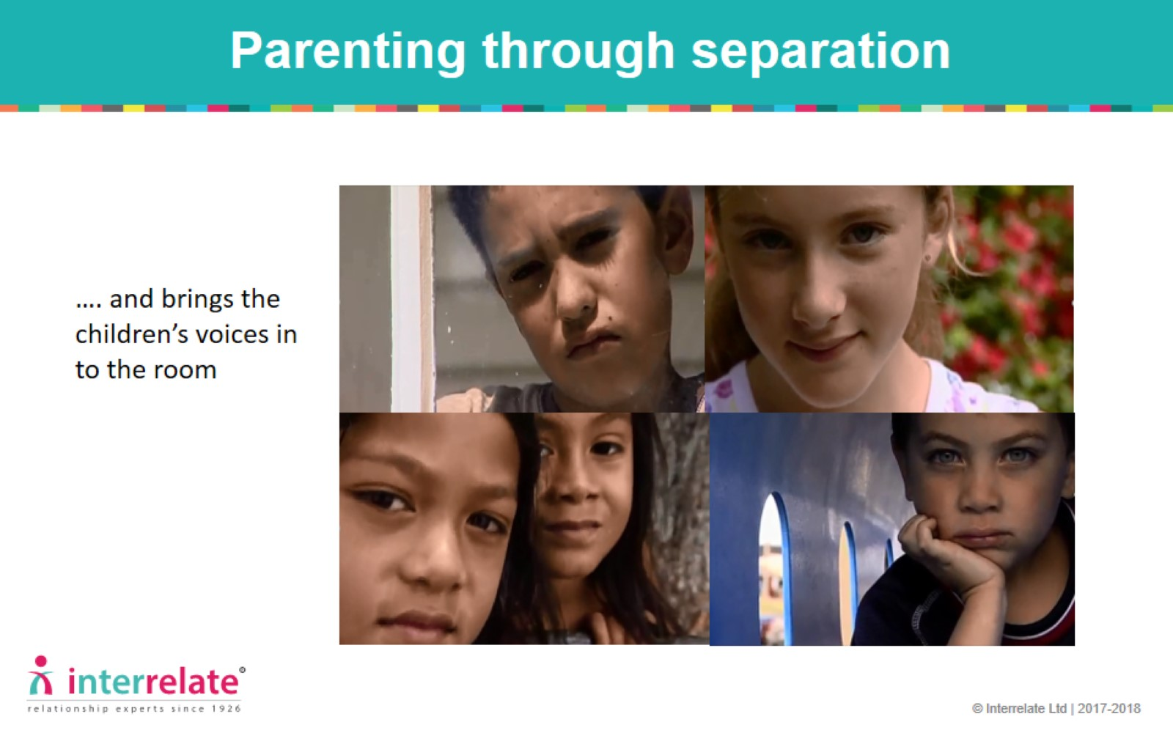
Parenting through separation

Slide 10
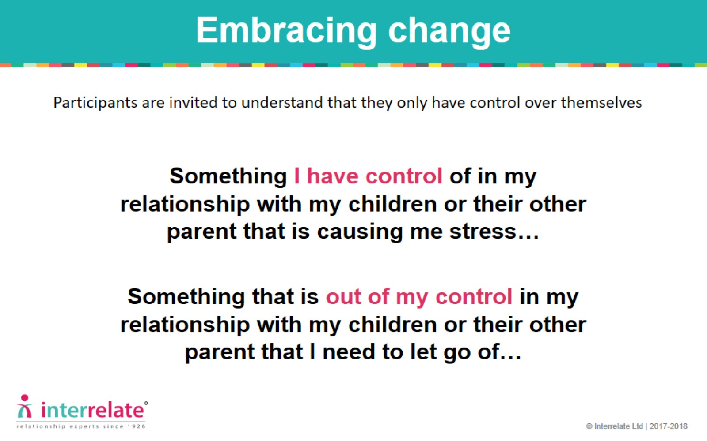
Embracing change

Slide 11
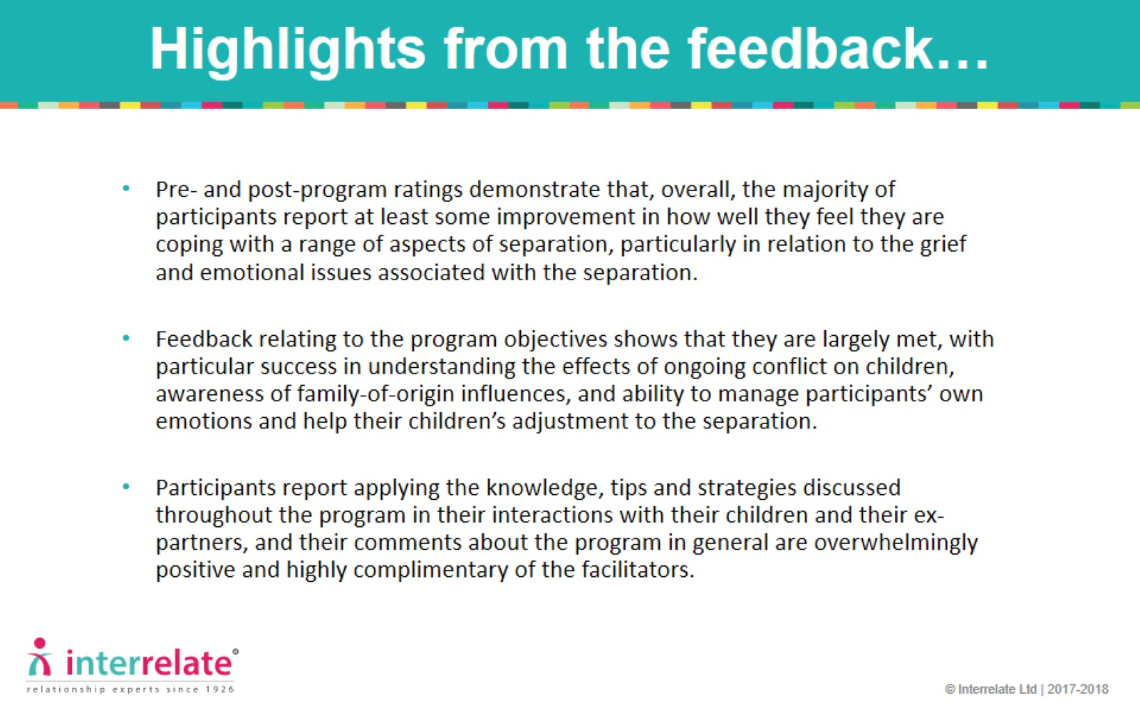
Highlights from the feedback…

Slide 12

For more information contact
Mary Tiller 02 4016 0512 or
Email: training@interrelate.org.au

